Slide 1
S o l d i e r H e a l t h M o n i t o r i n g
a n d
P o s i t i o n T r a c k i n g S y s t e m
By: Parithosh Dinesh Poojary (17BEC7050)
Guide: Dr.Suseela Vappangi

Slide 2
C O N T E N T S
Introduction
Objective
Progress schedule
Designing
Simulation
Hardware Implementation
Results
References
Project Schedule

Slide 3
I N T R O D U C T I O N
In today’s era, enemy warfare is an important factor in any nation’s security.
The national security mainly depends on Army, Navy and Air-Force. The important and vital role is played by the soldiers.
So, to support this technological idea, in this project I have come up with a system which will track soldiers position as well as give their health status during a operation/mission.
This system in particular will be useful for individuals, who involve in missions or in special operations.

Slide 4
O B J E C T I V E
To track the location and monitor the health of the soldier in real time, who get lost and injured in the battlefield, and also to minimize the time of search and rescue operation efforts of army control unit.

Slide 5
A P P L I C A T I O N S
D E F E N C E F O R C E S
The project can be implemented in battlefield or high altitude areas where health and location of soldiers is the most basic information which should be known to the control room.
C I V I L I A N S
This project can also be utilized by individuals who work in remote areas or high altitudes wherein the most basic information should be known to someone dear to them or their guardian’s.

Slide 6
P R O G R E S S S C H E D U L E
SEPTEMBER 24, 2020
D E S I G N I N G
Designing of the model based on the objective.
SEPTEMBER 28, 2020
S I M U L A T I O N
Simulation of project based on the first drafted design and simultaneously simulating every individual components ordered.
OCTOBER 03, 2020
H A R D W A R E I M P L E M E N T A T I O N
Implementing the first part/section of the project with hardware components acquired.

Slide 7
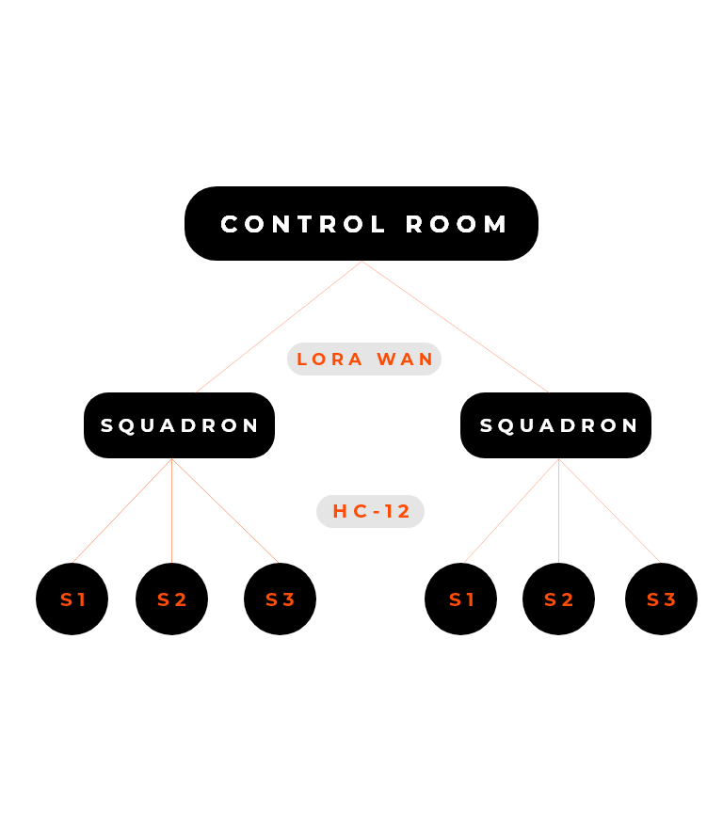



D E S I G N I N G
S1,S2,S3 - Soldiers
Soldiers are the key player that play a role in the whole system – they are equipped with multiple sensors ..i.e. Temp sensor (LM-35), Pulse sensor (RC-A-4015), GPS sensor (Neo-6M), RF transmitter (HC-12) and an Arduino UNO.
Squadron Leader
Squadron leader is placed at level 2, so that information is received to him before it is received to the control room, as to take action a bit earlier if some mishap occurs. The squadron leader would also be equipped with sensors ..i.e. RF receiver (HC-12), Temp sensor(LM-35), LoRa WAN transmitter (SX-1278) and an Arduino UNO.
Control Room
This is level 3, where all the information received through the LoRa WAN (SX-1278) is stored in a place.

Slide 8
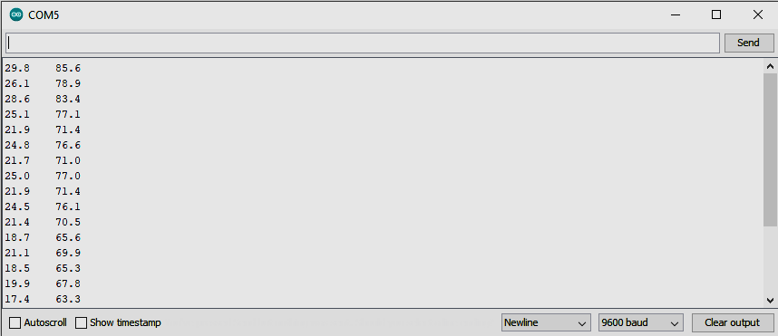
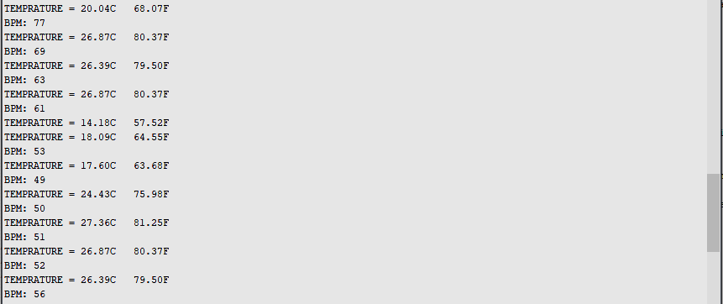
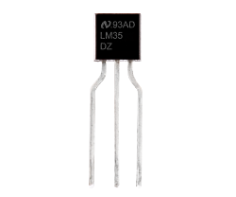
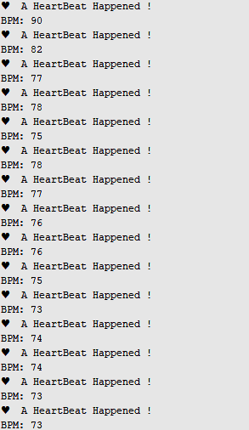
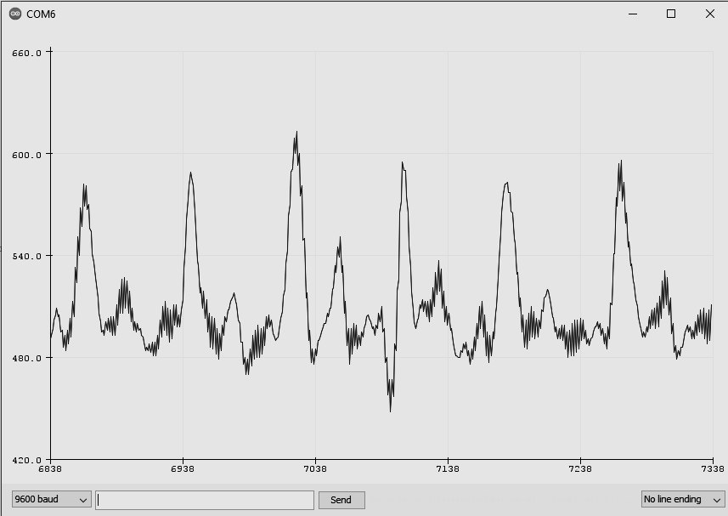
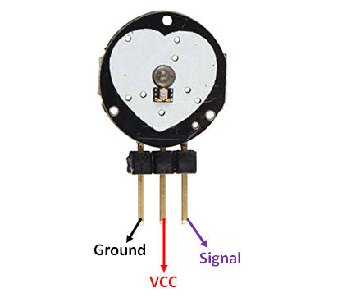
S I M U L A T I O N
Temp Sensor (LM-35)
LM-35 is a precession Integrated circuit Temperature sensor, whose output voltage varies, based on the temperature around it. It is a small and cheap IC which can be used to measure temperature anywhere between -55°C to 150°C.
LM-35
(LM-35) + (RC-A-4015)
Pulse Sensor (RC-A-4015)
A pulse wave is the change in the volume of a blood vessel that occurs when the heart pumps blood, and a detector that monitors this volume change is called a pulse sensor. RC-A-4015 does the same work by using a led, which emits light and simultaneously receives the emitted light and accordingly processes the light to provide an analog value of the heartbeat.
RC-A-4015

Slide 9
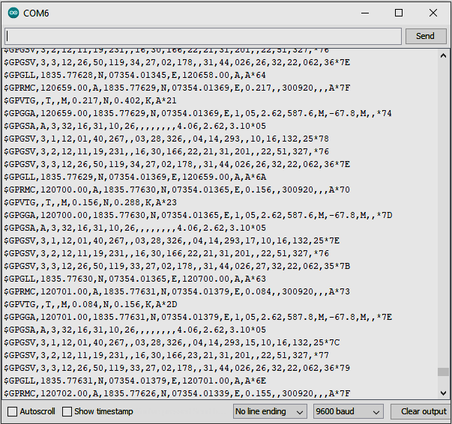
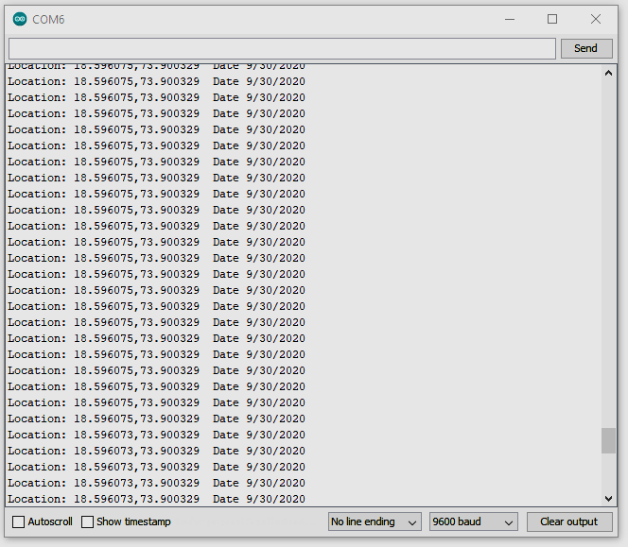
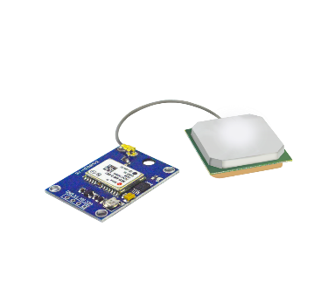
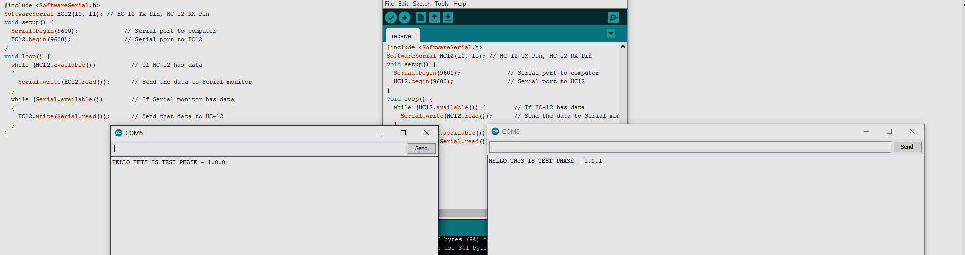
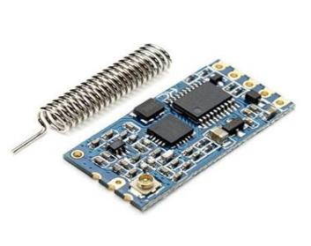
S I M U L A T I O N
GPS Sensor (Neo-6M)
GPS sensors are receivers with antennas that use a satellite-based navigation system with a network of 24 satellites in orbit around the earth to provide position, velocity, and timing information.
Neo-6M (NMEA Data)
Neo-6M(Lat,Lon and Date Data)
RF Sensor (HC-12)
The HC-12 is a half-duplex wireless serial communication module with 100 channels in the 433.4-473.0 MHz range that is capable of transmitting up to 1 km.
HC-12 (Transmitter and Receiver)

Slide 10
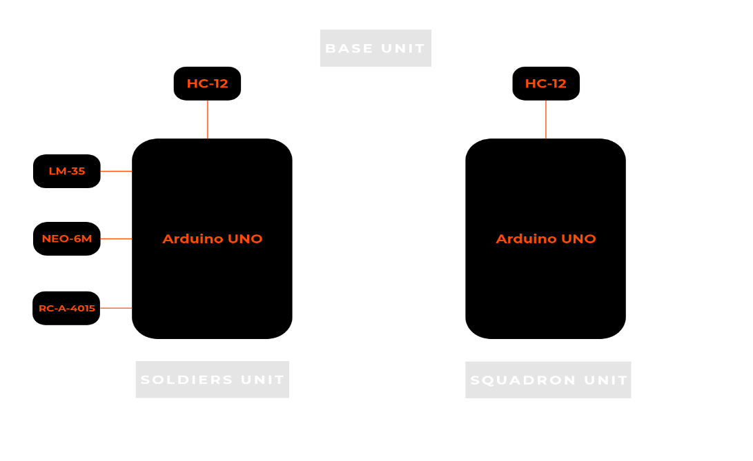
H A R D W A R E I M P L E M E N T A T I O N
Block diagram
Soldiers unit (Health and Position data) Squadron unit

Slide 11
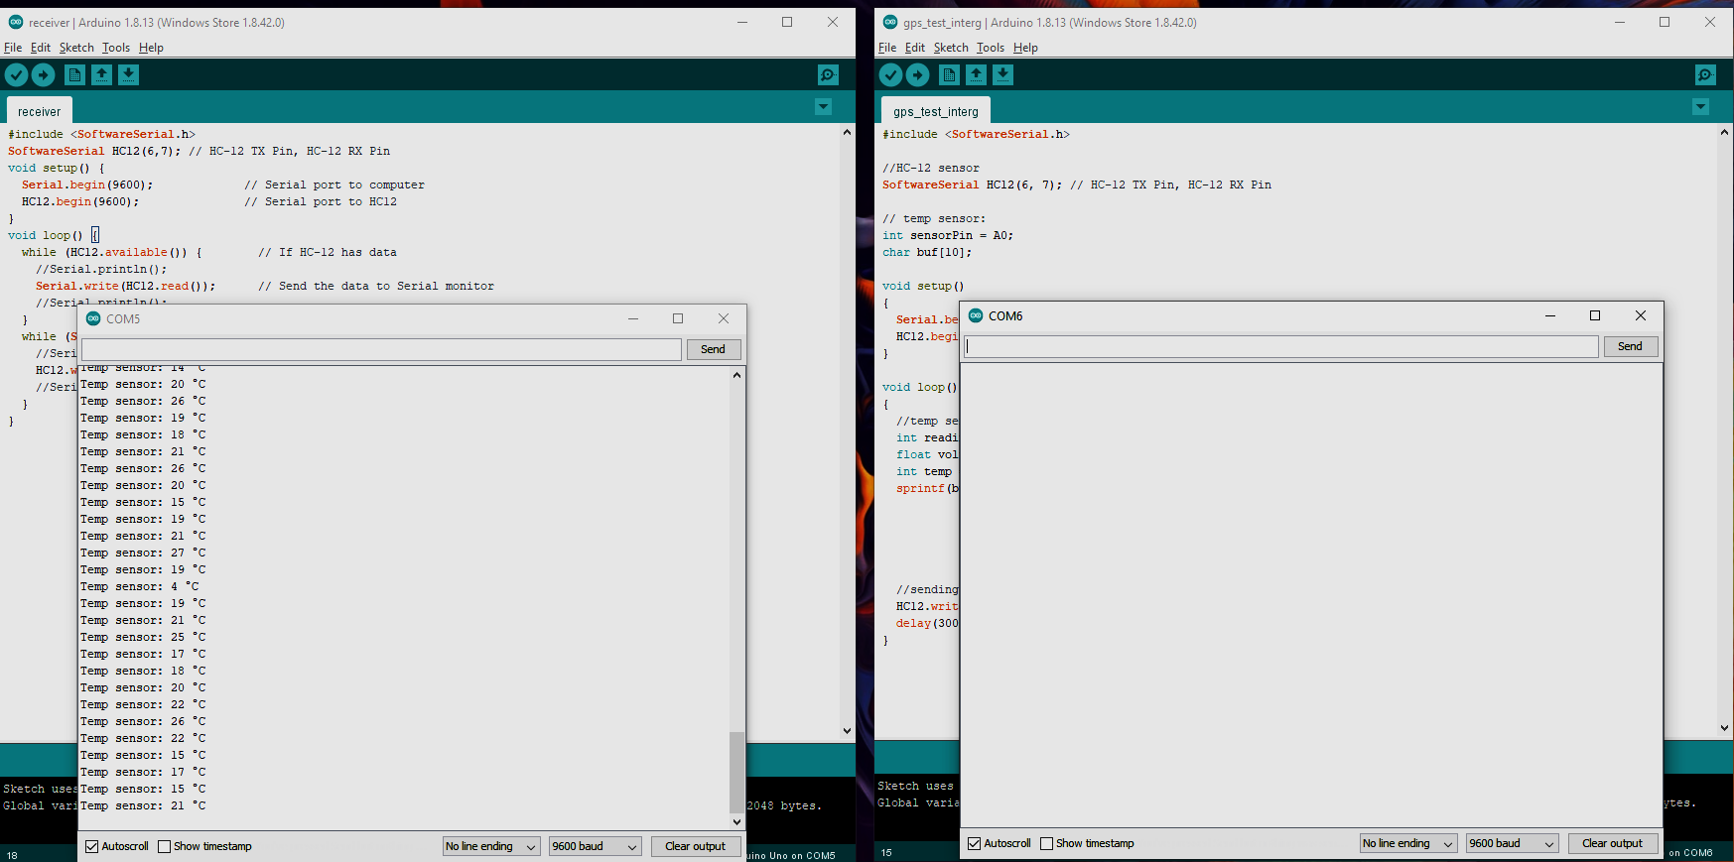
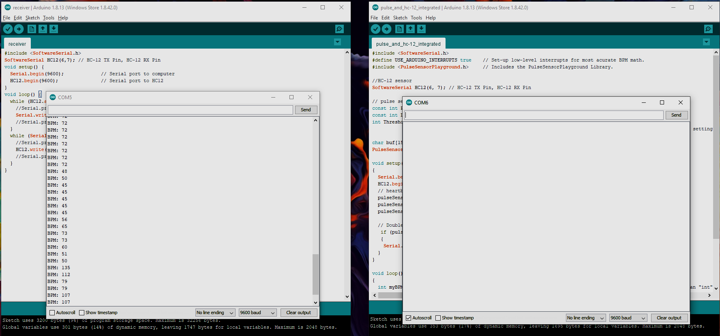
H A R D W A R E I M P L E M E N T A T I O N
Successfully implemented with the base level of the project ..i.e. sending the data collected from the soldiers S-Health system that comprises (Temp sensor, Pulse sensor, GPS sensor, HC-12 transmitter and Arduino UNO) to the squadron leader unit that has the HC-12 receiver.
LM-35 and HC-12 Integrated
RC-A-4015 and HC-12 Integrated

Slide 12
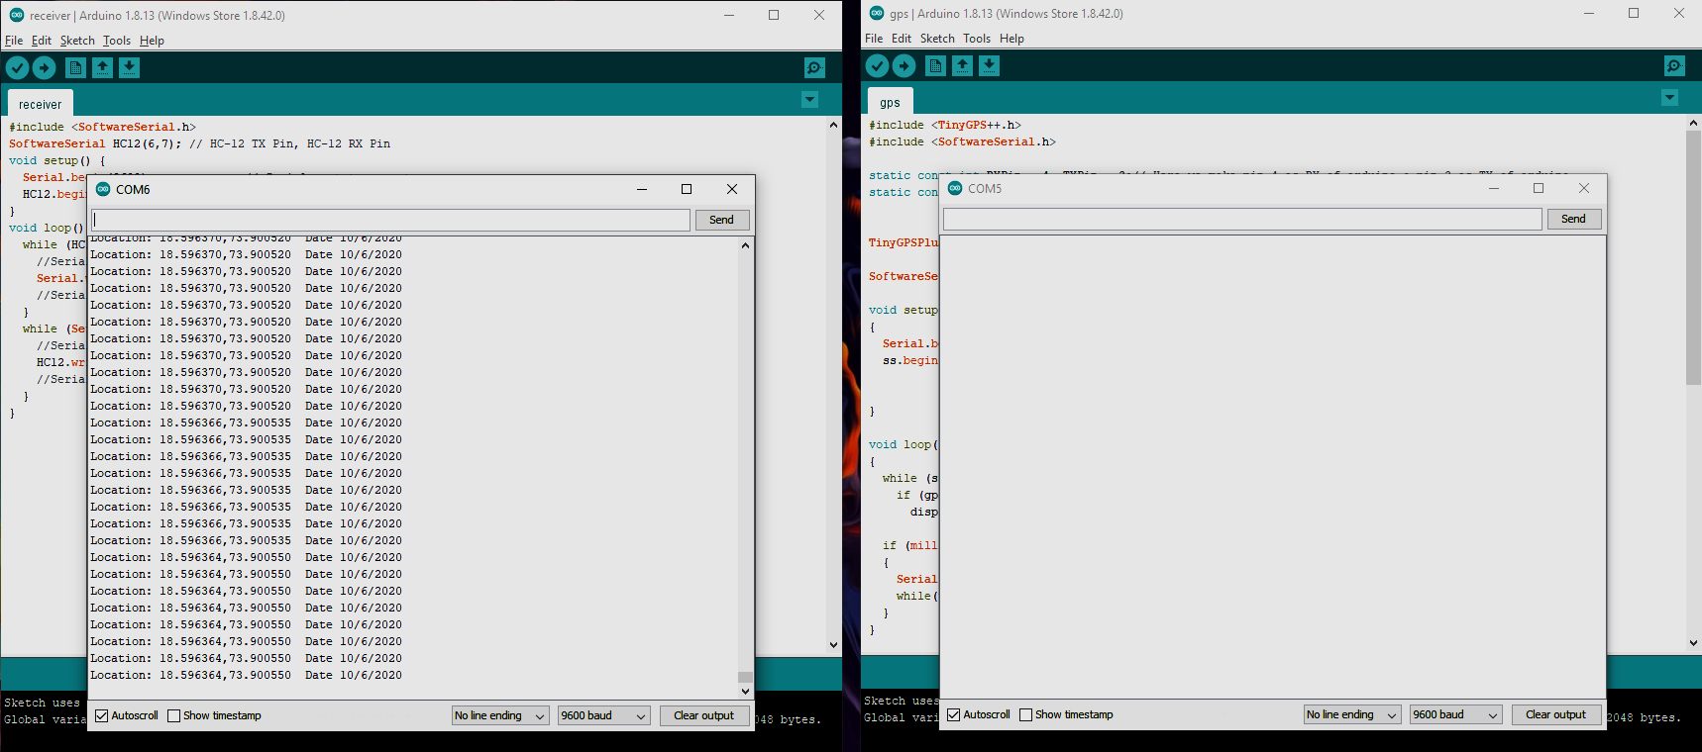
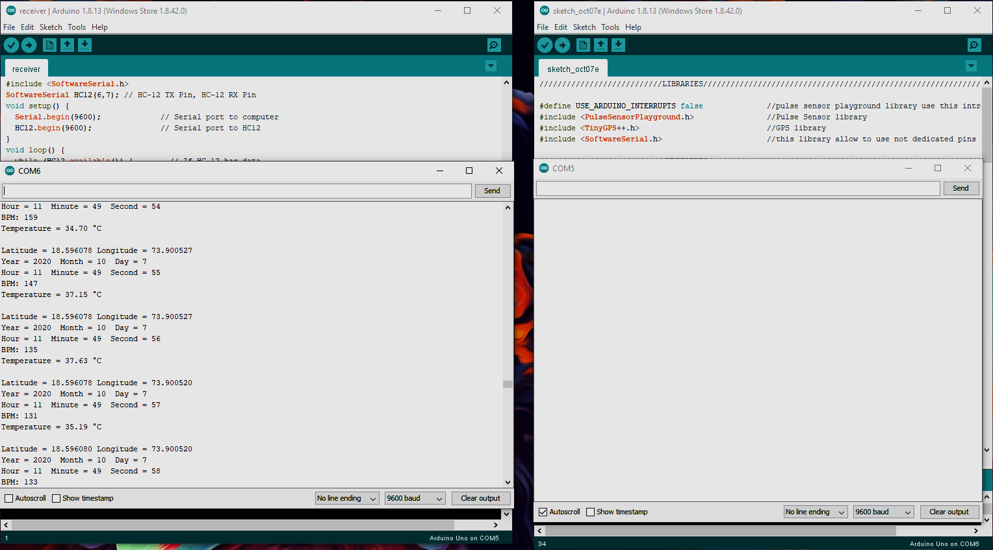
H A R D W A R E I M P L E M E N T A T I O N
NEO-6M and HC-12 Integrated
LM-35, RC-A-4015 and NEO-6M Integrated

Slide 13
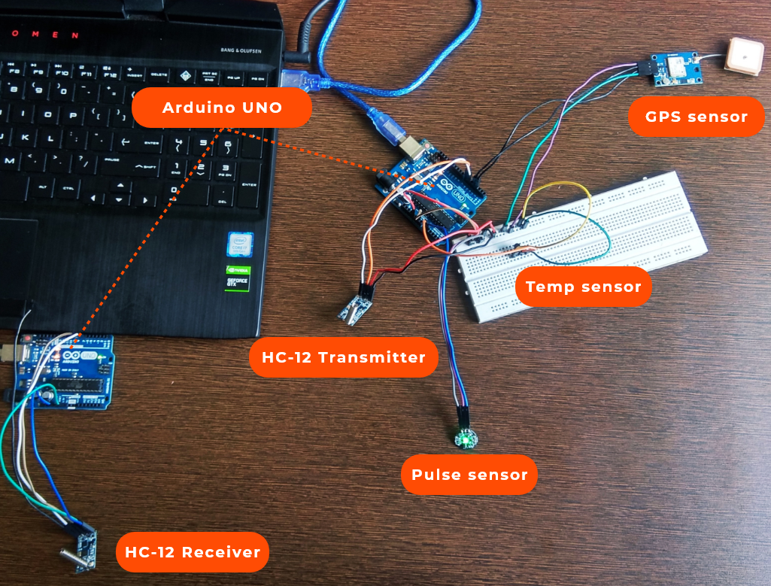
H A R D W A R E I M P L E M E N T A T I O N

Slide 14
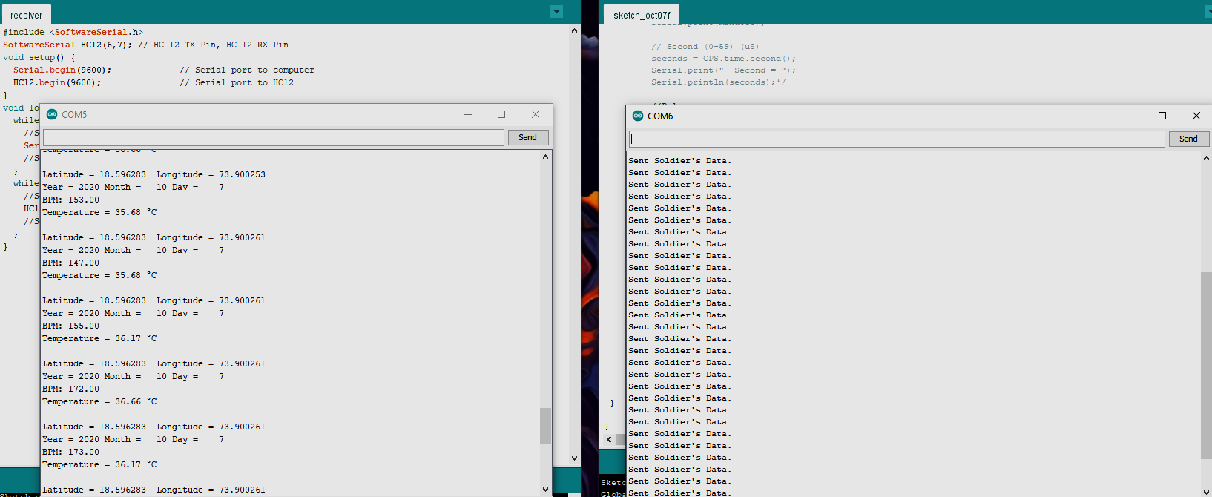
H A R D W A R E I M P L E M E N T A T I O N

Slide 15
R E S U L T
Successfully designed a model that meets the requirement of our objective.
Successfully simulated all the acquired components.
Successfully simulated the base level of the design..i.e. sending the data collected from the soldiers S-Health system to the squadron’s unit through RF module(HC-12).

Slide 16
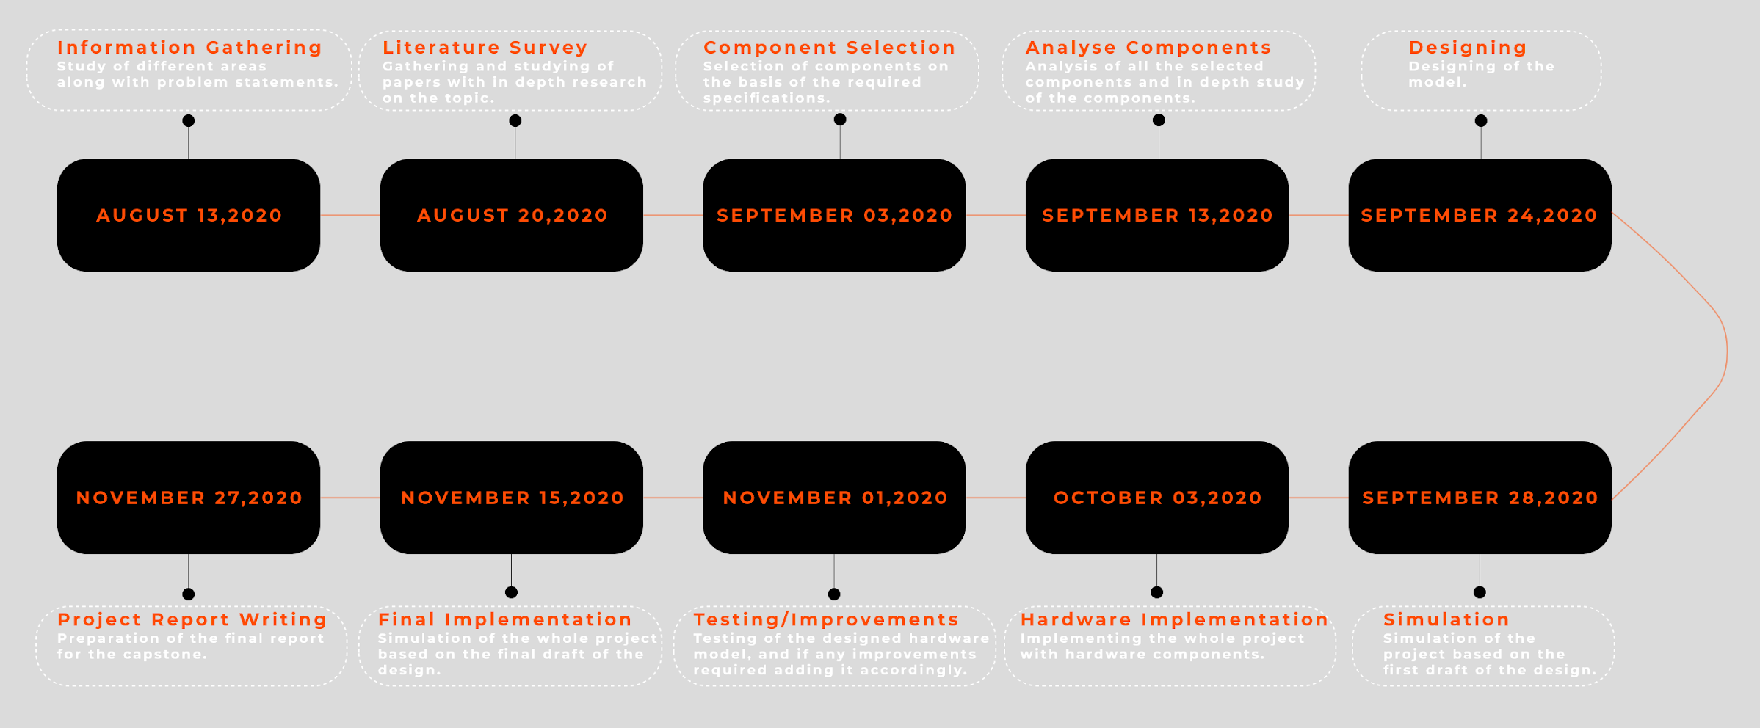
P R O J E C T S C H E D U L E

Slide 17
R E F E R E N C E S
Hock Beng Lim, Di Ma, Bang Wang, Zbigniew Kalbarczyk, Ravishankar K. Iyer, Kenneth L. Watkin (2010); “A Soldier Health Monitoring System for Military Applications”.
William Walker, A. L. Praveen Aroul, Dinesh Bhatia; “Mobile health monitoring system”.
Shweta Shelar, Nikhil Patil, Manish Jain, Sayali Chaudhari, Smita Hande; “Soldier Tracking And Health Monitoring Systems”.
P.S. Kurhe, S.S. Agrawal (2013); “Real Time Tracking and Health Monitoring System of Remote Soldier Using ARM 7”.
www.allaboutcircuits.com/projects/understanding-and-implementing-the-hc-12-wireless-transceiver-module

Slide 18
THANK YOU
ANY QUESTIONS ?

